Slide 1
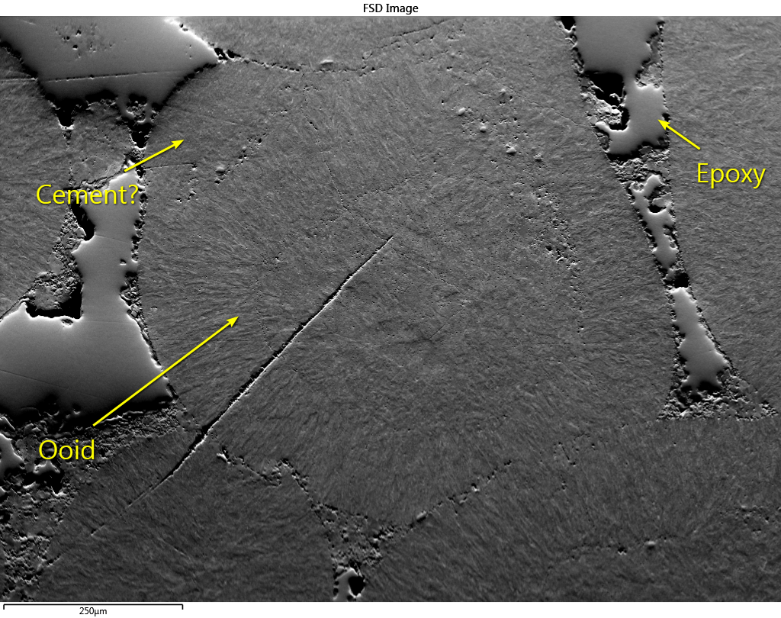
SEM: Sigma 500 FEG
Acc. Volt: 20 kV
EBSD: AZtec Symmetry
Cond.: Low Vacuum.

Slide 2
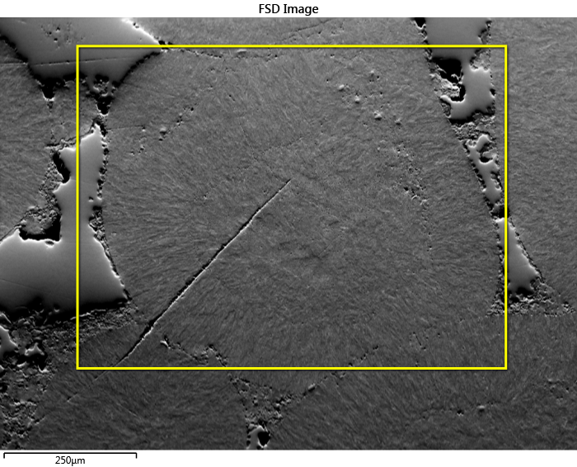
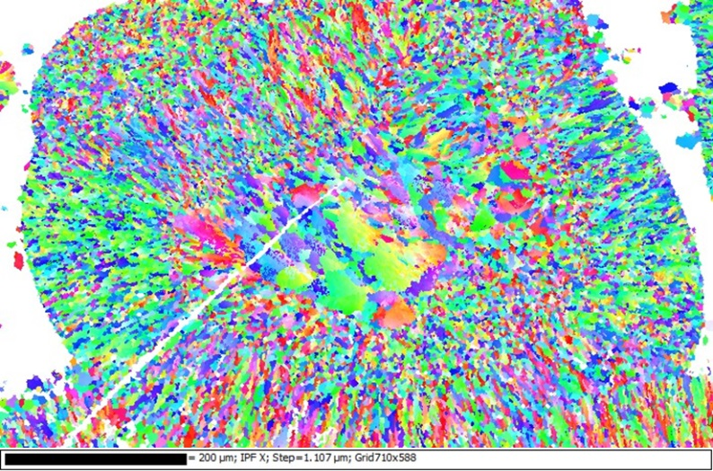
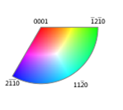
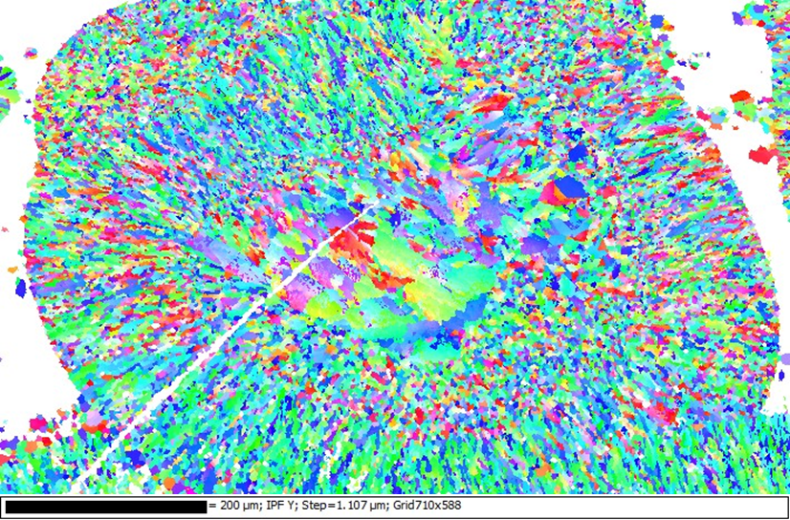
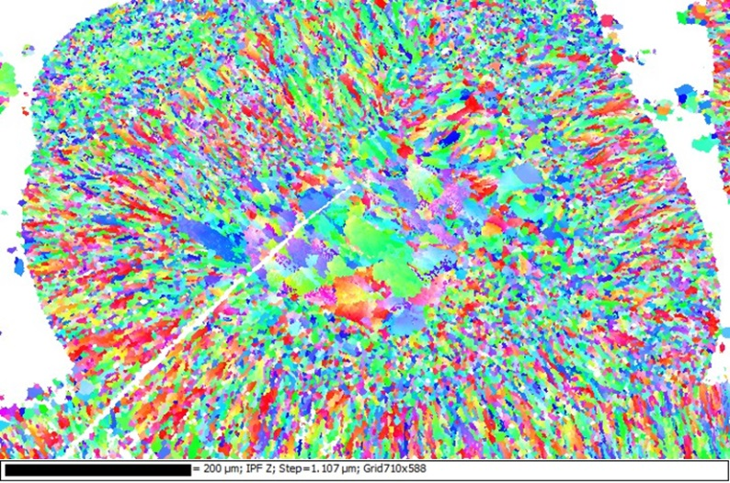
IPF X-direction
IPF Y-direction
IPF Z-direction
Orientation data (inverse pole figure maps) were collected on the ooid at low magnification and low mapping resolution (right).
Acquisition rate was ~65 Hz and the acquisition time was 1hour and 23 mintues.
Due to the quality of the patterns a noise reduction of medium and systematic misindexing correction was applied.

Slide 3
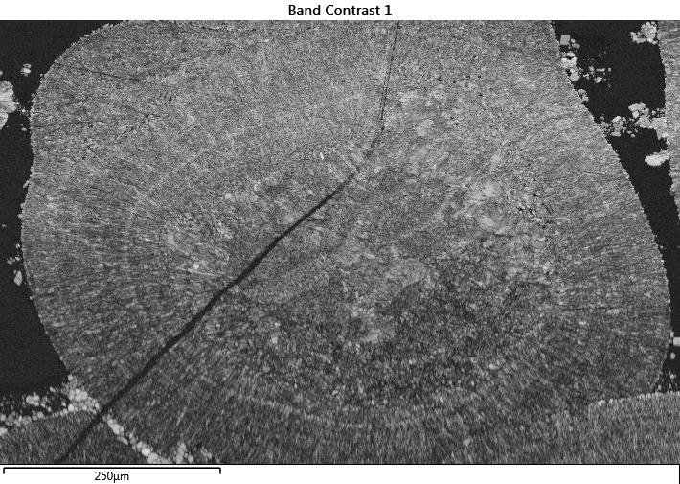
A band contrast map of ooid is shown on the right. A band contrast map shows the quality of pattern obtained at each pixel. A bright pixel indicates the pattern had high contrast and a dark pixel indicates a poor pattern was acquired.
Band contrast maps reveal grain structure that is often difficult to see in the electron image or orientation maps.

Slide 4
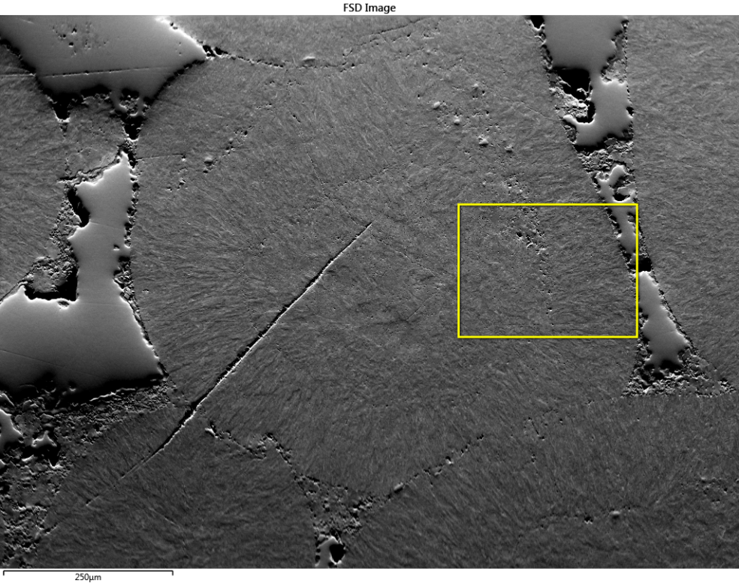
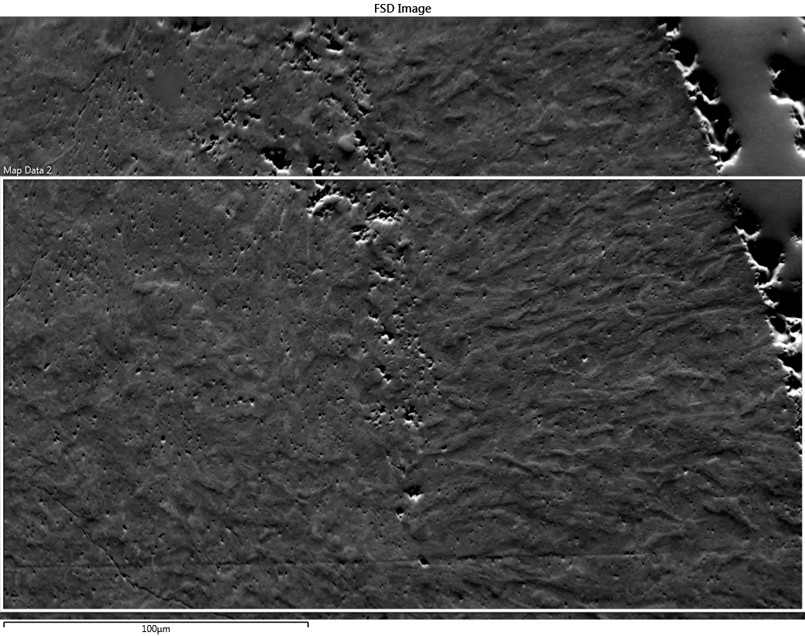
A second orientation map set was collected at higher magnification and higher map resolution. The yellow box shown in the FSE image above shows the location of the region shown on the right. The white box shows the acquisition area for the high magnification maps.

Slide 5

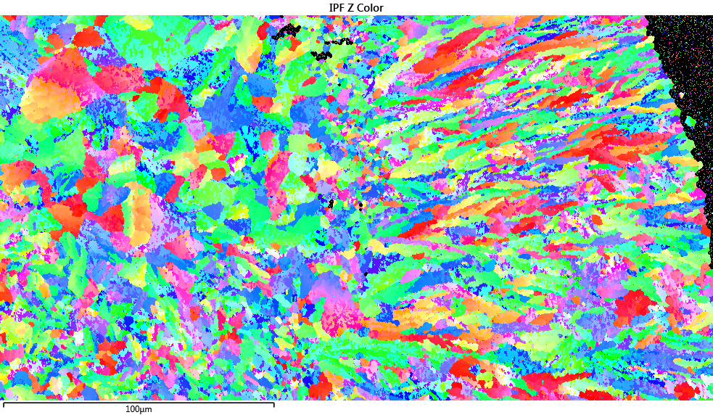
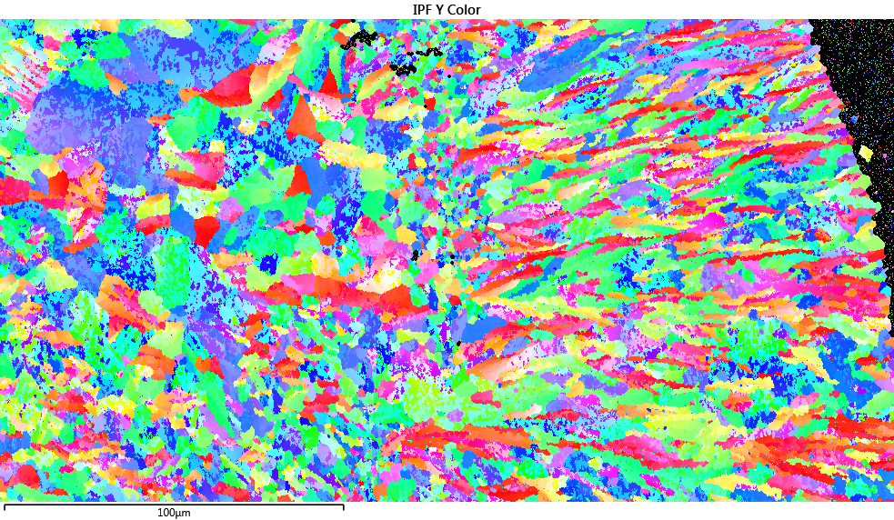
Inverse pole figure maps for the Z-direction and Y-direction are shown on the right.

Slide 6
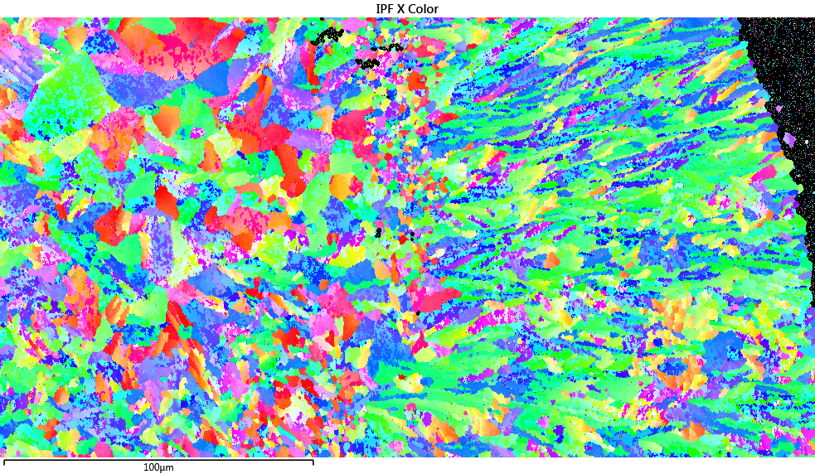
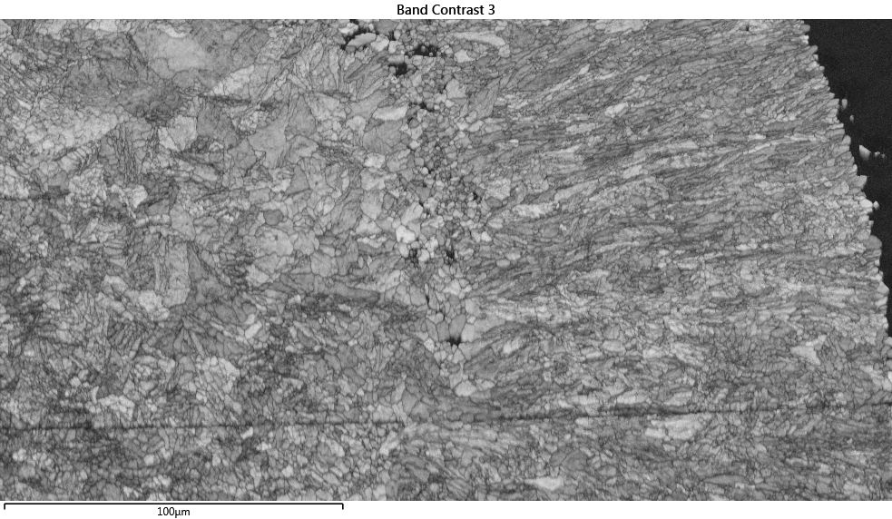
Inverse pole figure map for the X-direction and band contrast map are shown on the right.

Slide 7
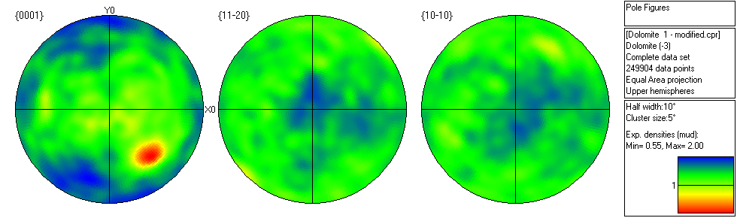
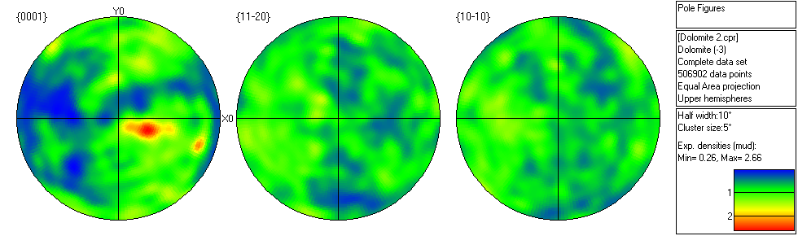
Pole figures for the Low Magnification data set (top) and for the higher magnification dataset (bottom).

